Slide 1
B₁
B₃
B₆
B₇
m₁
7, 15, 13
14, 8
5
12
0
9
B₂
30
B₄
58
68
B₅
90
m₂
10
3, 6
4, 1, 2, 11, 9
0
7
27
67
94

Slide 2
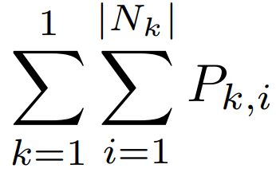
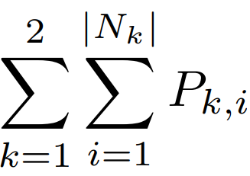
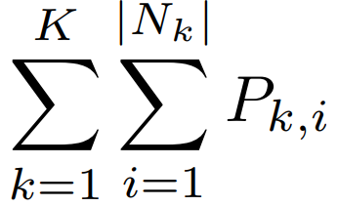
S₁
S₂
...
S_{k}
m₁
J1.1
J1.2
...
J1. |N1|
J2.1
J2.2
...
J2. |N2|
...
Jk.1
Jk.2
...
Jk. |Nk|
0

Slide 3
Sk = 88,180,301
S₃
S₁
S₂
M₁
5
3
6
2
1
6
V₃
5
3
TW
5
3
W₁
6
2
TW
2
V₂
1
4
1
4
0
100
200
300
400
500
600

Slide 4
B₁
B₃
B₆
B₇
m₁
7, 15
14, 8
5
12
0
8
B₂
25
B₄
53
63
B₅
85
m₂
10
6
4, 1, 2, 11, 9
0
7
27
53
80
B₁
B₃
B₆
B₇
m₁
7, 15
14, 8, 13
5
12
0
8
B₂
25
B₄
53
63
B₅
85
m₂
10
6
4, 1, 2, 11, 9
0
7
27
53
80
B₁
B₃
B₆
B₇
m₁
7, 15
14, 8, 13
5, 3
12
0
8
B₂
25
B₄
53
68
90
B₅
m₂
10
6
4, 1, 2, 11, 9
0
7
27
53
80

Slide 5
B₁
B₃
B₆
B₇
m₁
7, 15
14, 8
5
12
0
8
B₂
25
B₄
53
63
B₅
85
m₂
10
6
4, 1, 2, 11, 9
0
7
27
53
80
B₁
B₃
B₆
B₇
m₁
7, 15
14, 8, 13
5
12
0
8
B₂
25
B₄
53
63
B₅
85
m₂
10
6
4, 1, 2, 11, 9
0
7
27
53
80
B₁
B₃
B₆
B₇
m₁
7, 15
14, 8, 13
5, 3
12
0
8
B₂
25
B₄
53
68
90
B₅
m₂
10
6
4, 1, 2, 11, 9
0
7
27
53
80

